Slide 1




Unit 5
Rectangular, Polar, Cylindrical, and Spherical coordinate systems
In single-variable calculus, we use a definite integral such as
In double integration, we accumulate over a two-dimensional region.
$$\iint_{R}{f}\left(x , y\right) dA$$
Similarly, a triple integral $\iiint_{V}{f}\left(x , y , z\right) dV$ accumulates a quantity throughout a three-dimensional solid $V$.

Slide 2
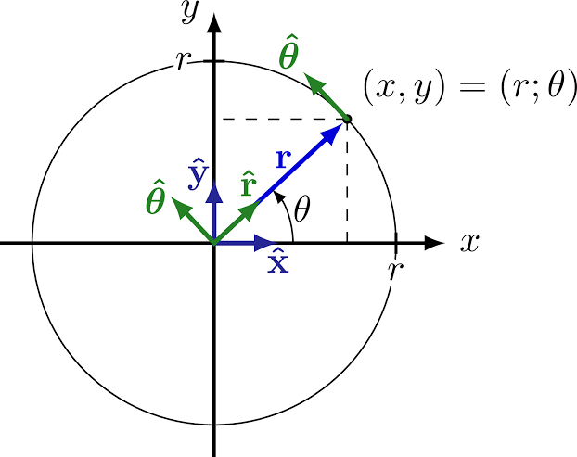
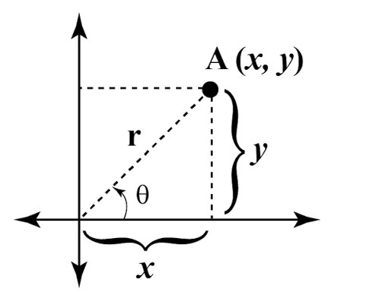
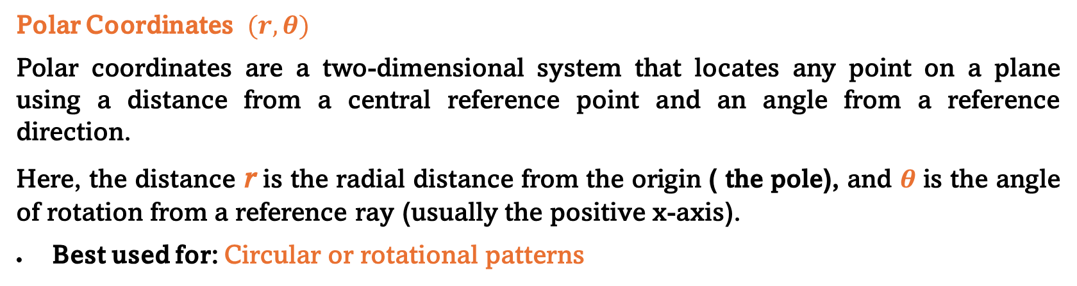
Rectangular, Polar, Cylindrical, and Spherical coordinate systems
Polar Coordinates $(r, θ)$
Polar coordinates are a two-dimensional system that locates any point on a plane using a distance from a central reference point and an angle from a reference direction.
Here, the distance r is the radial distance from the origin ( the pole), and θ is the angle of rotation from a reference ray (usually the positive x-axis).
Best used for: Circular or rotational patterns

Slide 3
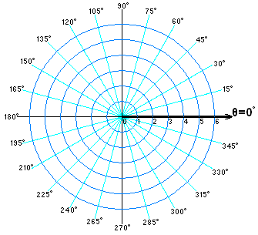
Polar Coordinates $(r, θ)$

Slide 4
Rectangular, Polar, Cylindrical, and Spherical coordinate systems
Why Do We Need Different Coordinate Systems?
A coordinate system is simply a language for locating a point. The choice of coordinate system is important because it can make the limits of integration and the integrand much simpler.

Slide 5


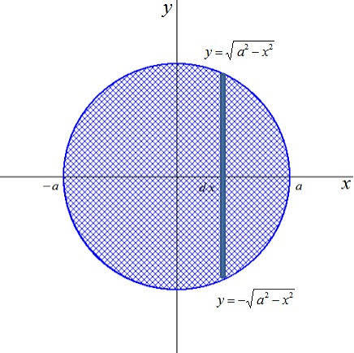
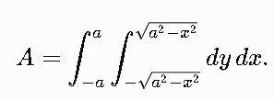
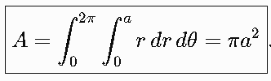
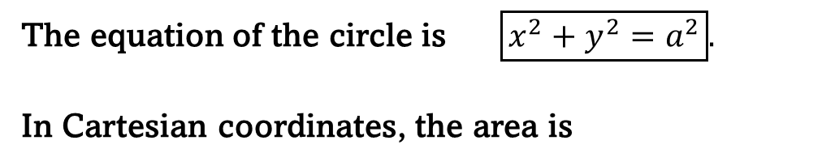
Rectangular, Polar, Cylindrical, and Spherical coordinate systems
The equation of the circle is $\boxed{x^{2}+y^{2}=a^{2}}.$
In Cartesian coordinates, the area is

Slide 6



The Jacobian
The Jacobian is a mathematical factor that tells us how area, volume, or higher-dimensional volume changes when we change from one coordinate system to another.
Why do we need the Jacobian?
This is especially important when converting a multiple integral from one coordinate system to another.
Suppose we have a double integral in Cartesian coordinates:
In Cartesian coordinates:

Slide 7
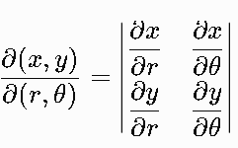


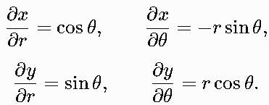
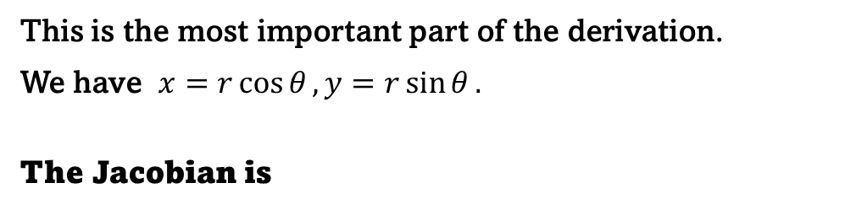
Polar Coordinates $(r, θ)$
This is the most important part of the derivation.
We have $x=r\cos{θ}, y=r\sin{θ}.$
The Jacobian is
When we change variables, the Jacobian tells us how much a tiny area or volume element is stretched or compressed by that transformation.

Slide 8

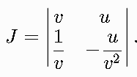


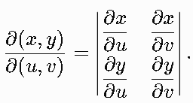



Polar Coordinates $(r, θ)$
Find the Jacobian, when given
Therefore,
The Jacobian is
Calculate the partial derivatives:

Slide 9
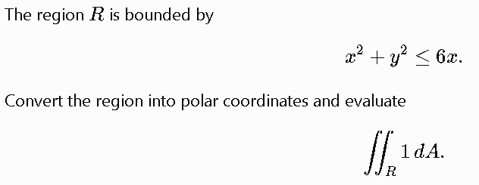
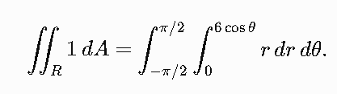
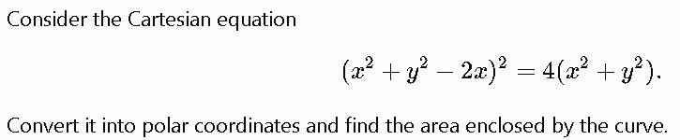



Exercise 01
Exercise 02

Slide 10


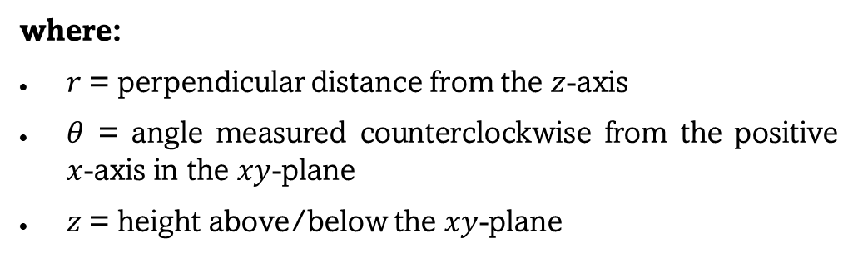
What are cylindrical coordinates?
Cylindrical coordinates locate a point in three-dimensional space using a radius, an angle, and a height (r, θ, z).
Cylindrical coordinates are the natural 3-dimensional extension of polar coordinates. They are particularly useful when a problem has circular symmetry around the z-axis, such as cylinders, cones, spheres, pipes, tanks, and rotational solids.
In Cartesian coordinates, a point in 3D is represented by $\left(x , y , z\right).$ Whereas, in cylindrical coordinates, the same point is represented by
where:
$r$= perpendicular distance from the $z$-axis
$θ$ = angle measured counterclockwise from the positive $x$-axis in the $xy$-plane
$z$= height above/below the $xy$-plane
So cylindrical coordinates essentially combine:

Slide 11

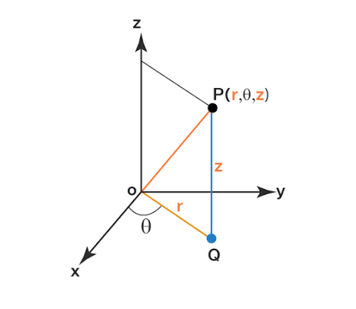
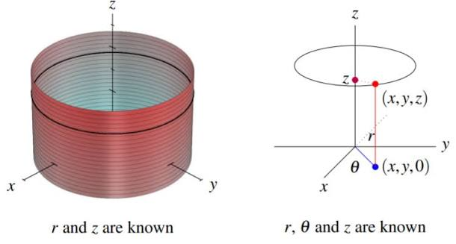



Conversion between Cartesian and cylindrical coordinates
From polar coordinates, $x=r\cos{θ},$ $y=r\sin{θ}.$
The $z$-coordinate remains unchanged:

Slide 12


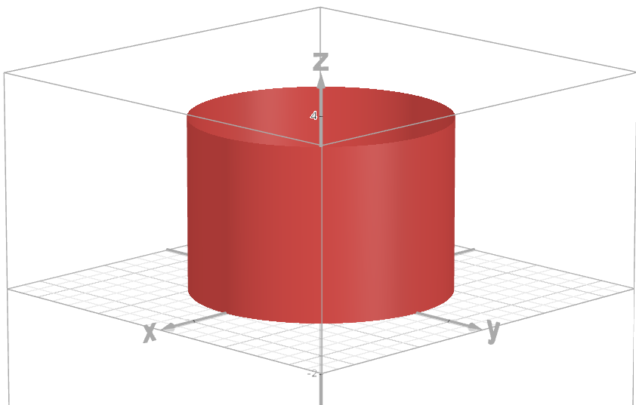
Problem
Find the volume of the solid using cylindrical coordinates.

Slide 13

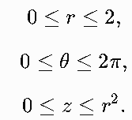


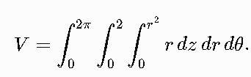
Problem
Find the volume enclosed by $z=x^{2}+y^{2}$ and x² + y² = 4
Convert the surfaces

Slide 14
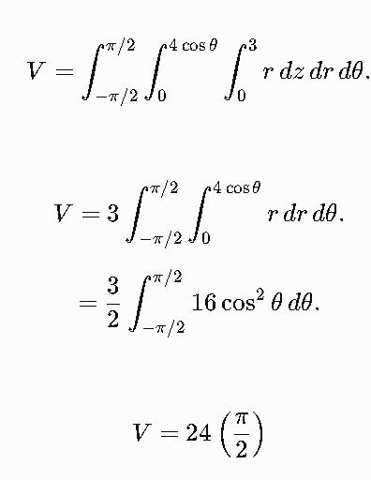
Problem
Find the volume inside $x^{2}+y^{2}≤4x$ and between $z=0$ and Z = 3

Slide 15
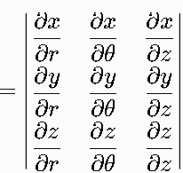
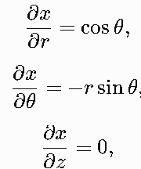
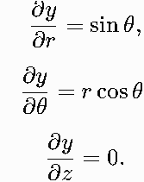
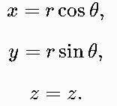





The Jacobian

Slide 16
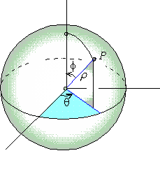
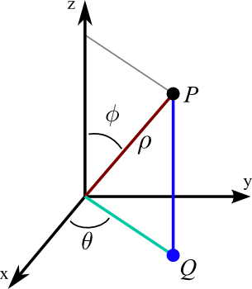
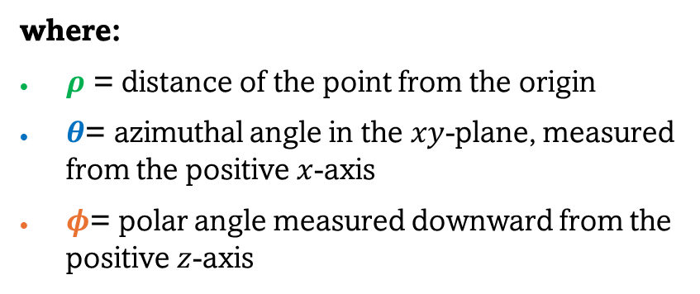
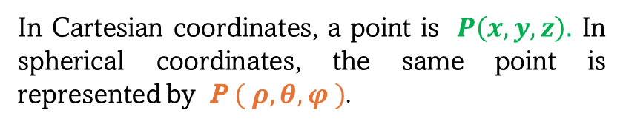
Spherical coordinate
Spherical coordinates specify the location of a point in three-dimensional space using one distance and two angles: radial distance (ρ), azimuth angle (θ), and polar/zenith angle (φ)
In Cartesian coordinates, a point is $P\left(x , y , z\right).$ In spherical coordinates, the same point is represented by P $( ρ, θ, φ )$.
where:
$ρ$ = distance of the point from the origin
$θ$= azimuthal angle in the $xy$-plane, measured from the positive $x$-axis
$φ$= polar angle measured downward from the positive $z$-axis
$$ρ≥0, 0≤φ≤π , 0≤θ≤2π$$

Slide 17

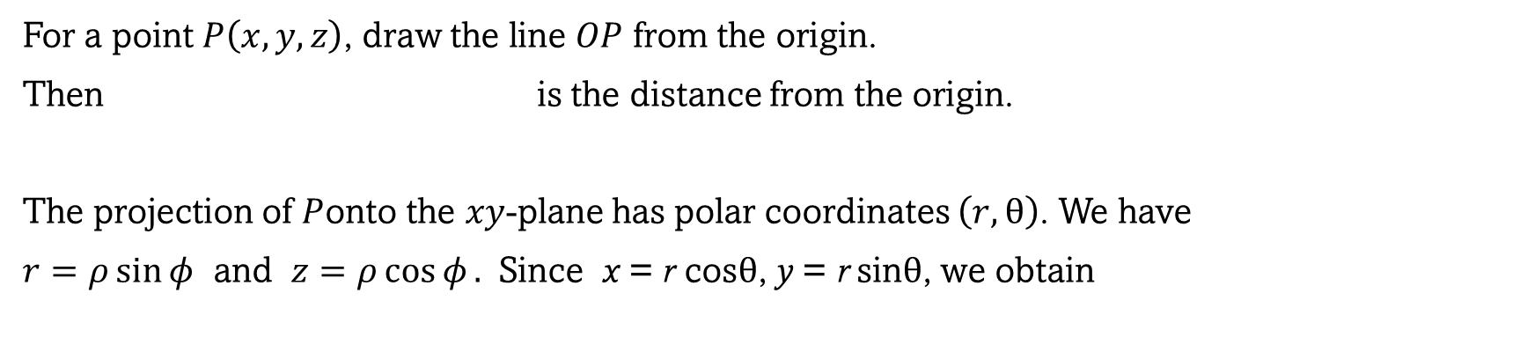
Polar Coordinates $(r, θ)$
For a point $P\left(x , y , z\right)$, draw the line $OP$ from the origin.
Then is the distance from the origin.
The projection of $P$onto the $xy$-plane has polar coordinates $\left(r , \text{θ}\right)$. We have
$r=ρ\sin{φ}$ and $z=ρ\cos{φ}.$ Since x = r cosθ, y = r sinθ, we obtain
$$\boxed{x=ρ\sin{φcos}θ} \\ \boxed{y=ρ\sin{φ}\sin{θ}} \\ \boxed{z=ρ\cos{φ}}.$$
These are the fundamental spherical-coordinate transformation

Slide 18
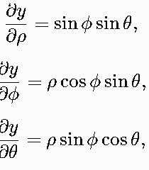
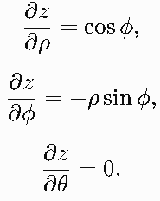
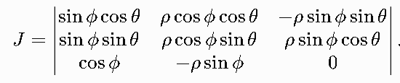

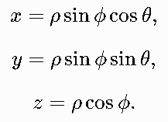
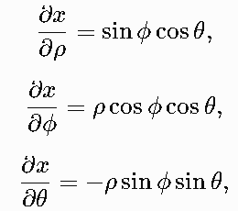


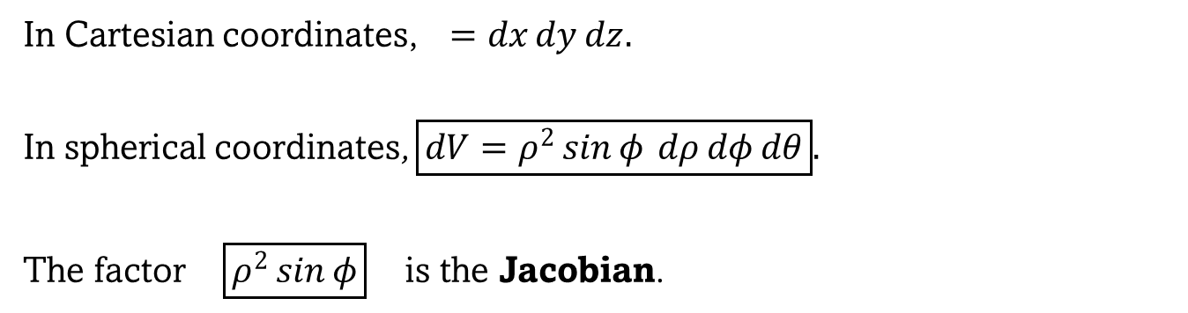
The Jacobian
In Cartesian coordinates, $=dx dy dz.$
In spherical coordinates, $\boxed{dV=ρ^{2}\sin{φ} dρ dφ dθ}.$
The factor $\boxed{ρ^{2}\sin{φ}}$ is the Jacobian.
Derivation of the Jacobian
We have

Slide 19


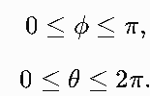


Problem Use spherical coordinates to find the volume of

